Slide 1
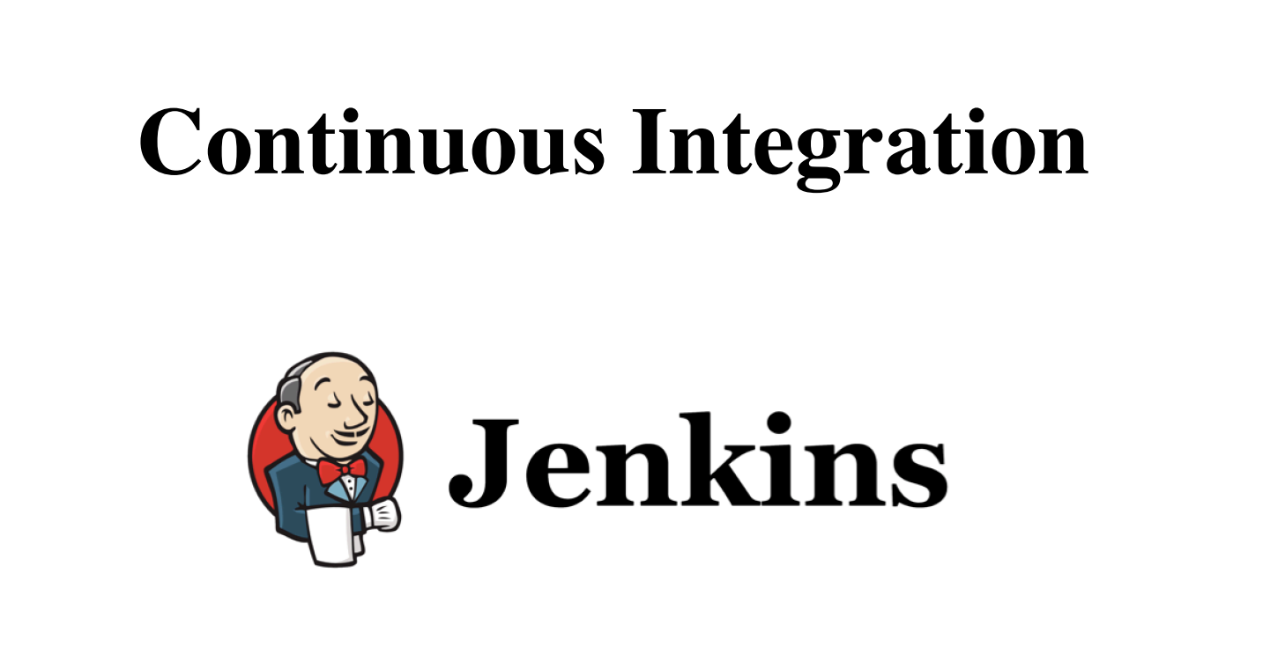
-By Shalini Maria Horo
Graduate Trainee, Feuji Inc.

Slide 2
What’s in it for you?
Before Jenkins
Issues before Jenkins
What is Jenkins ?
What is CI ?
CI Tools
Features of Jenkins
Jenkins Architecture
Jenkins Case Study

Slide 3
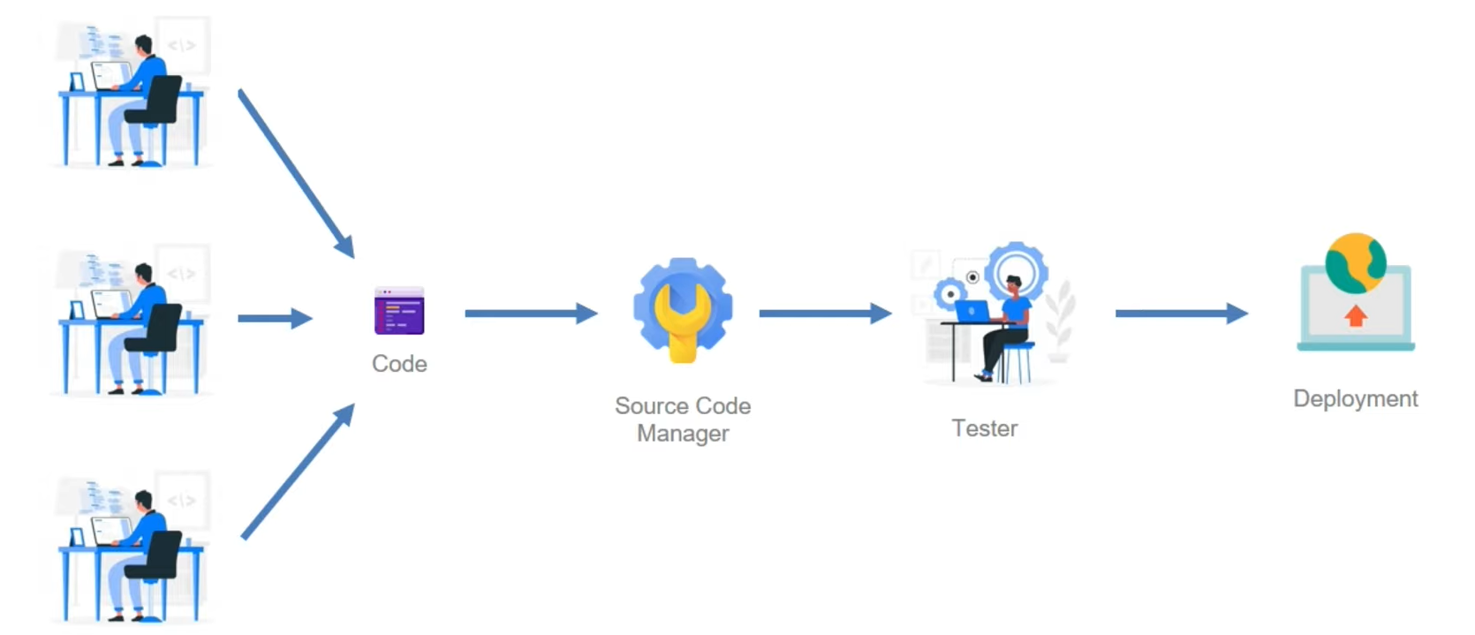
Standard Delivery Pipeline
Before

Slide 4
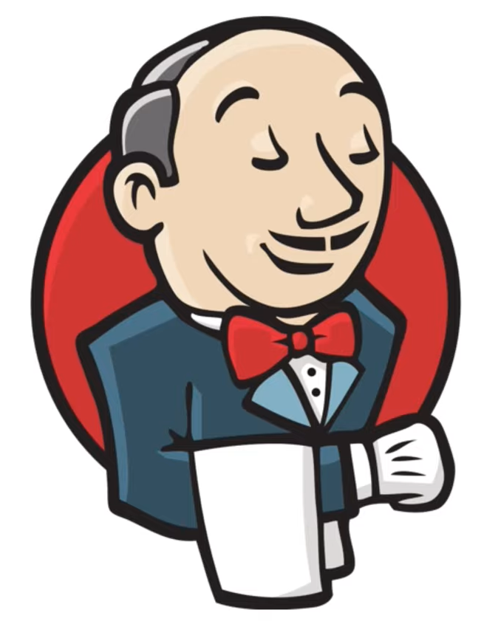
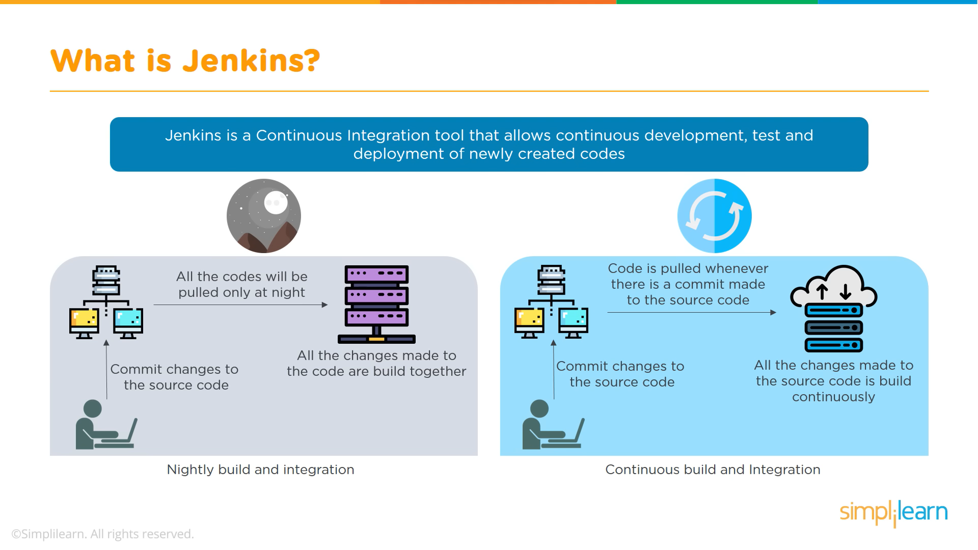
What is Jenkins?

Slide 5
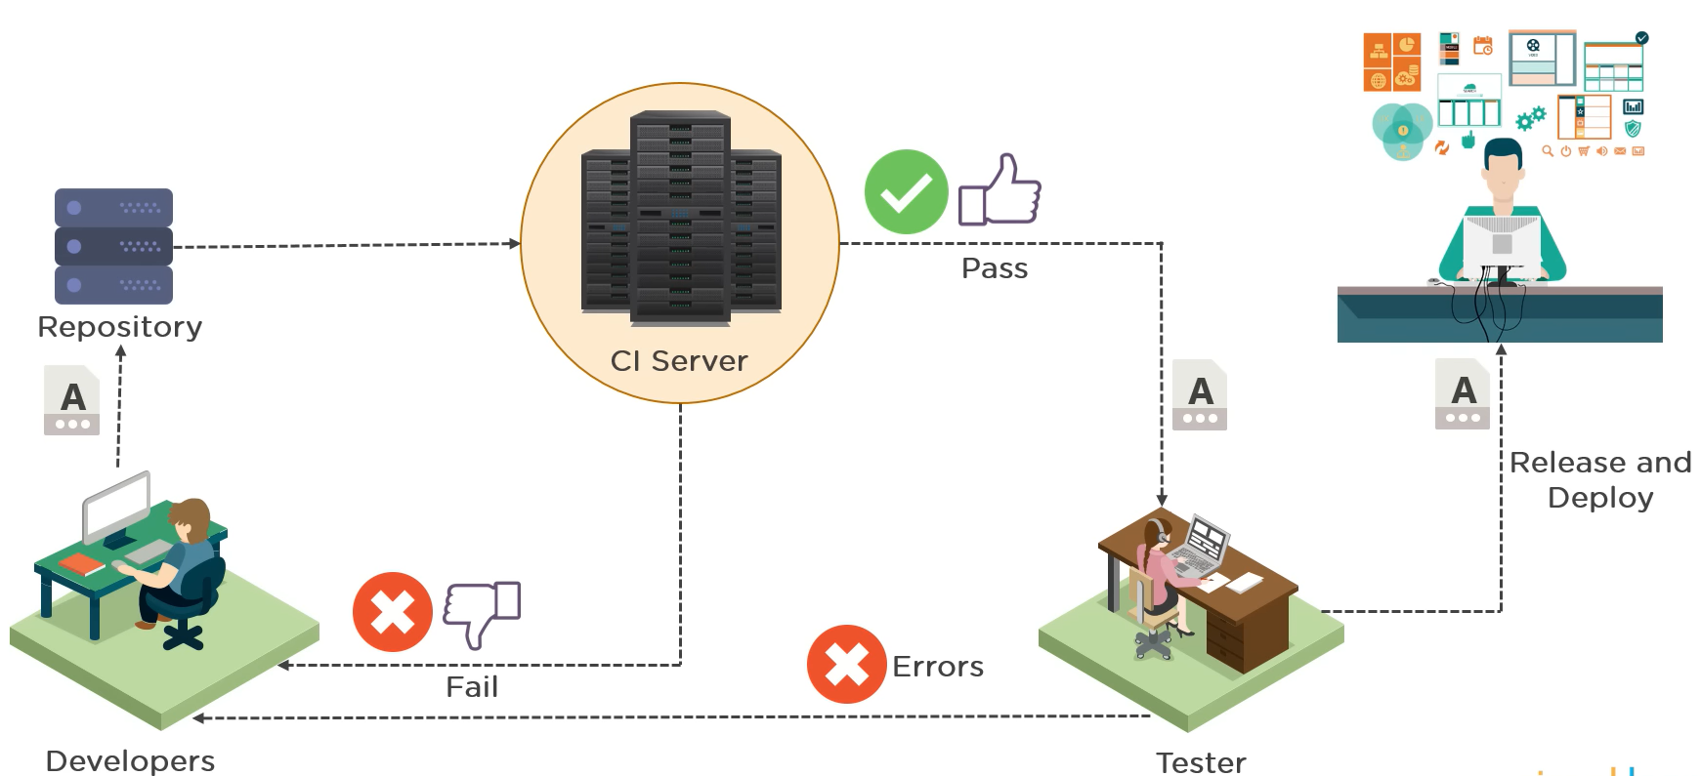
What is Continuous integration?

Slide 6
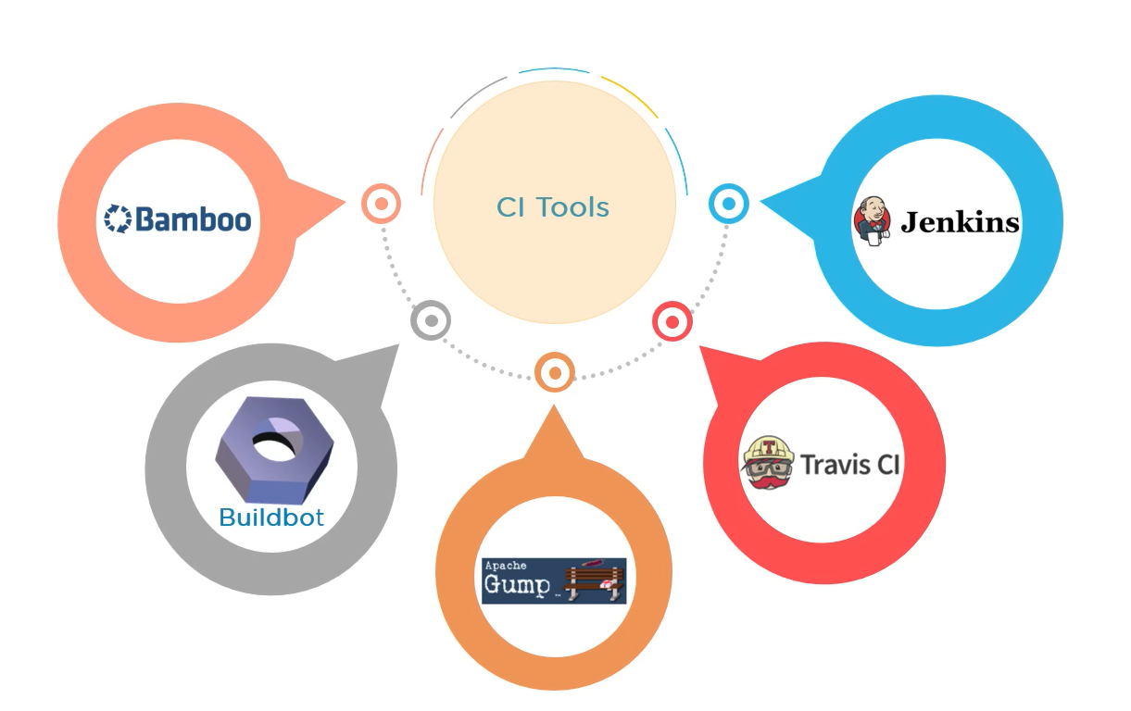
Continuous Integration Tools

Slide 7
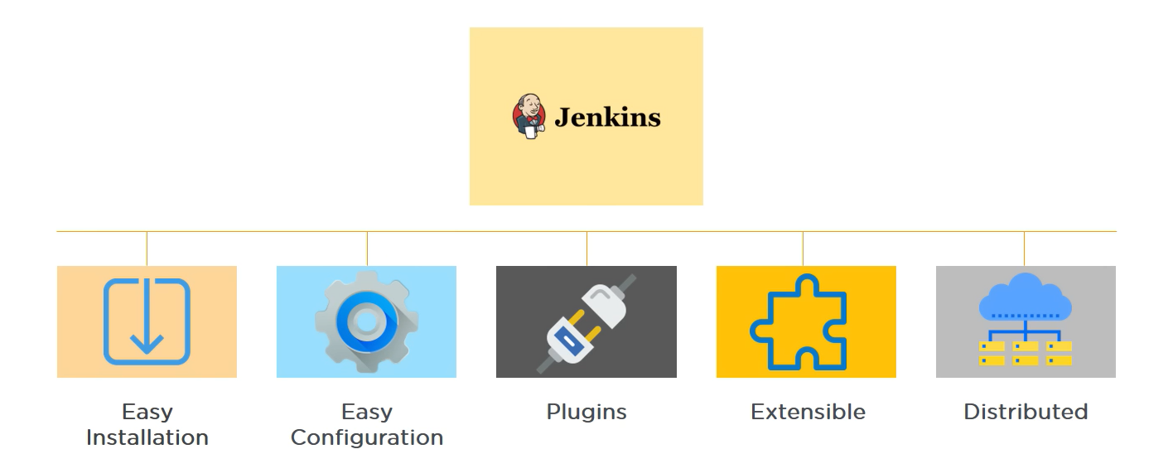
Features of Jenkins

Slide 8
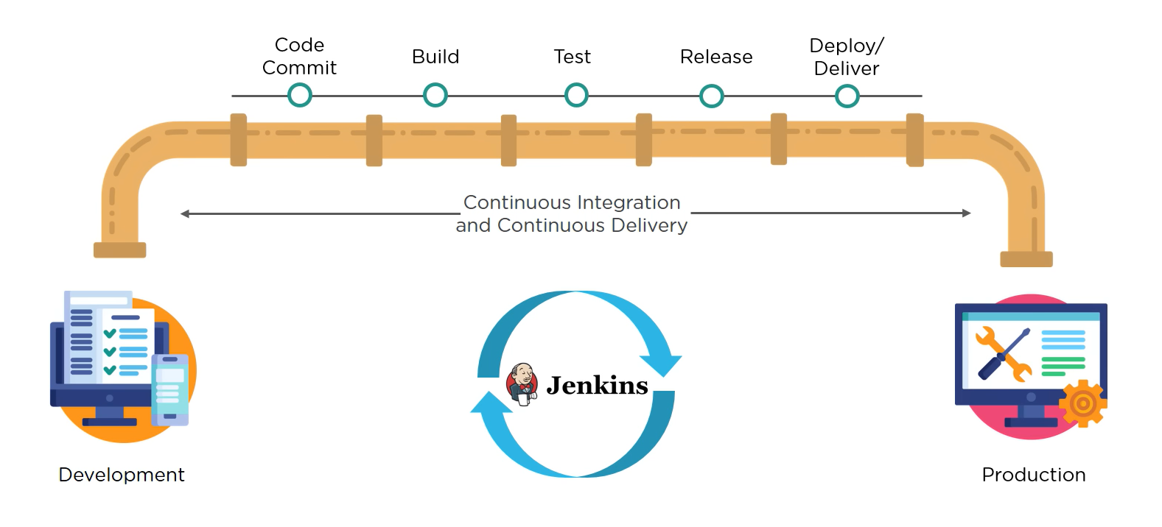
Jenkins Pipeline

Slide 9
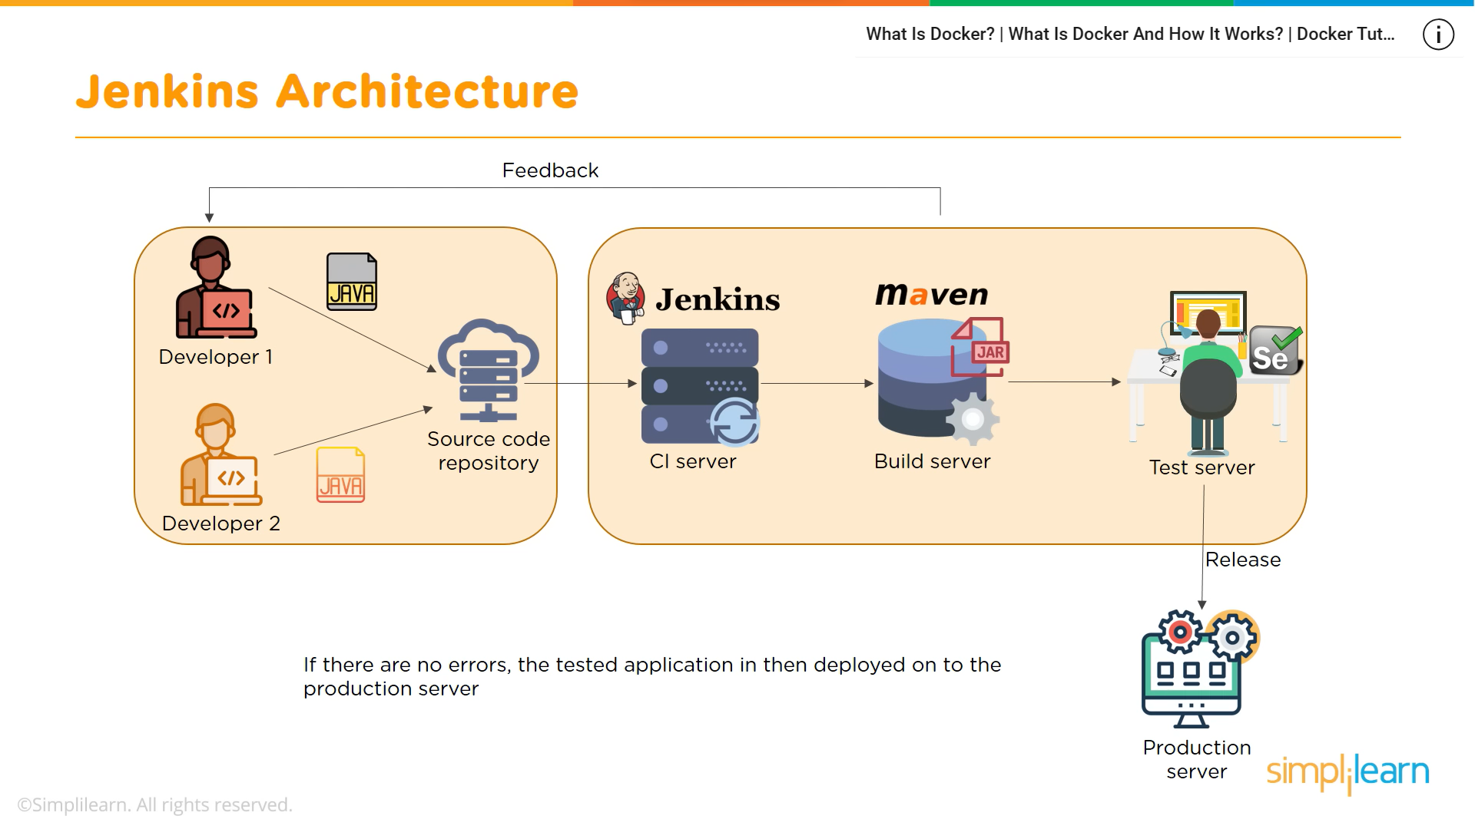
Jenkins Architecture

Slide 10
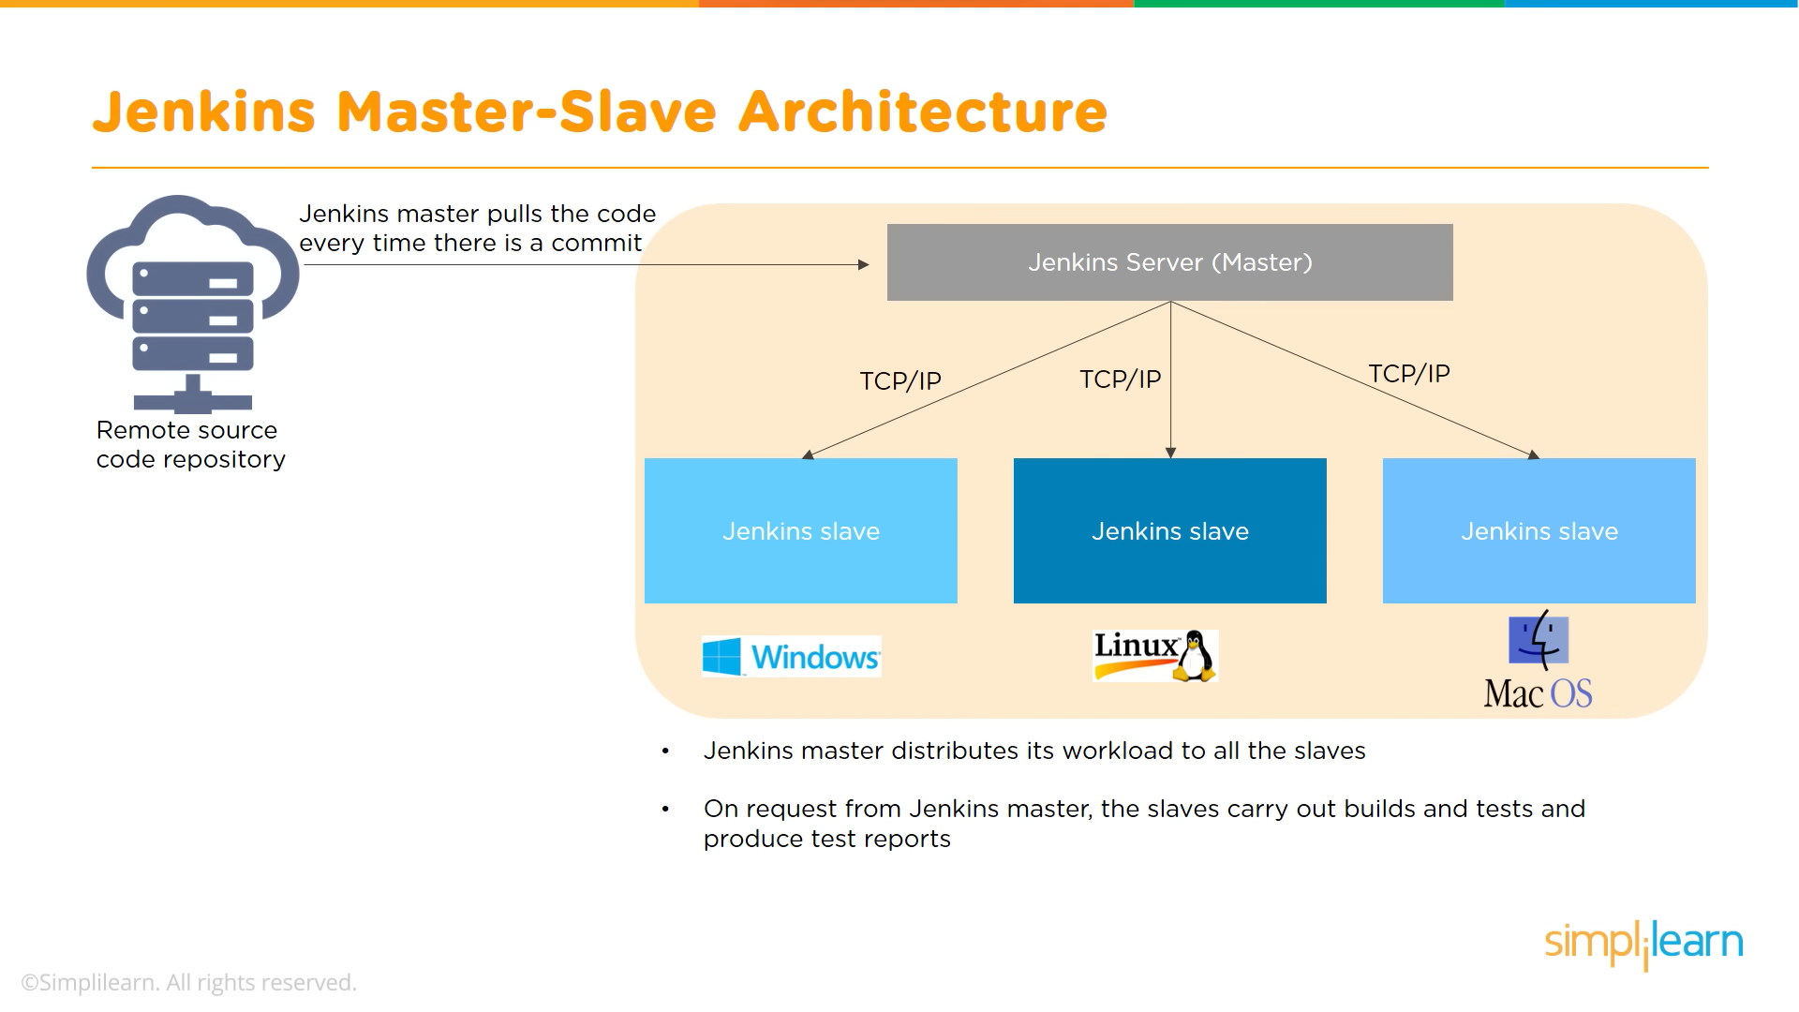
Jenkins Master-Slave Architecture

Slide 11
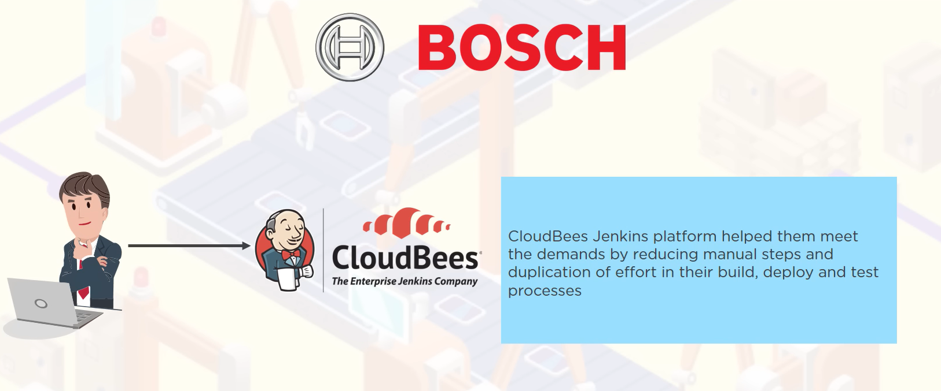
Jenkins Case Study

Slide 12
Thank you

